Slide 1
Containers & Docker
Nikolaos Astyrakakis (MTP235)

Slide 2
Virtualization
Benefits of virtualization
Resource efficiency:
Before virtualization, each application server required its own dedicated physical CPU—IT staff would purchase and configure a separate server for each application they wanted to run. (e.g Backup)
Easier management:
Easier to use and manage policies written in software.
(e.g Network Access)
Allows you to create automated IT service management workflows. (e.g Backup)
Minimal downtime:
OS and application crashes can cause downtime and disrupt user productivity. (e.g Multiple VMs)
Faster provisioning:
Buying, installing, and configuring hardware for each application is time-consuming.
A software-based or virtual representation of:
applications,
servers,
storage,
networks
Commonly called virtual machines (VMs)
Each VM runs its own operating system (OS), kernel and libraries
Behaves like a normal computer.
Requires a hypervisor to run on. (e.g. VirtualBox)
Supports Passthrough Hardware Virtualization
Supports Paravirtualization (Multiple Virtualization Layers) (depends on Hypervisor and hardware)
Virtualization brings several benefits to data center operators and service providers
Nikolaos Astyrakakis MTP235

Slide 3
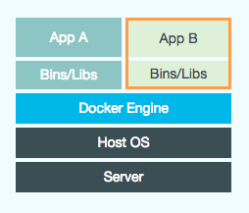
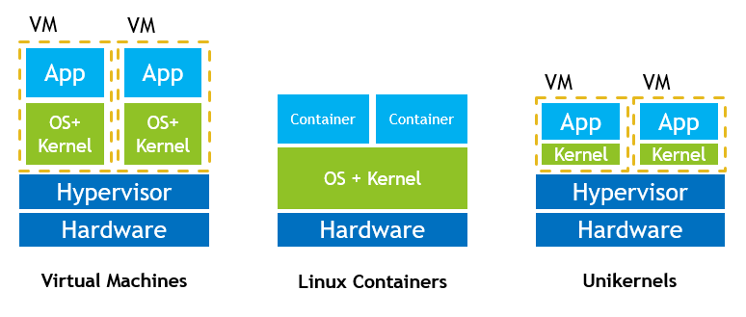
Container
Container is a compressed operating system with packed in libraries for running a specific category of applications or specific applications.
e.g Python Server, Java Server, Nodejs Server, etc.
Common policy: one application per container.
Utilize Host Kernel.
Container
Image
Operating system on top of another operating system
Container Image is the executable / runnable image of a whole application environment or system.
Uses a Container Image descriptor (e.g. Dockerfile)
Nikolaos Astyrakakis MTP235

Slide 4
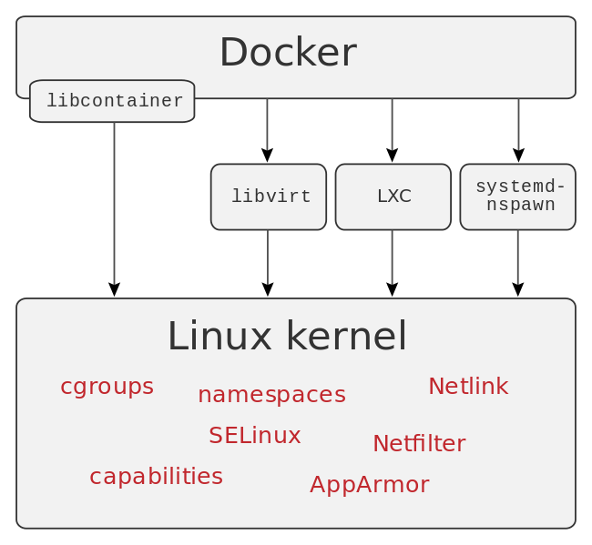
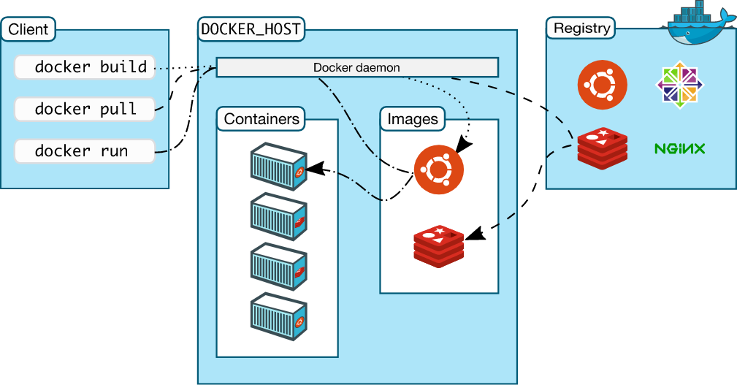
Docker and Containerd
Docker (Tool):
A tool to manage, delete and deploy containers.
It uses libraries to communicate with Linux Kernel and Containerd container runtime.
Command Line Tool (CLI)
Linux, MacOS, Windows / Windows Server (a lot of issues)
Containerd (Runtime):
An industry-standard container runtime
Available as a daemon for Linux.
It runs the containers.
Nikolaos Astyrakakis MTP235

Slide 5
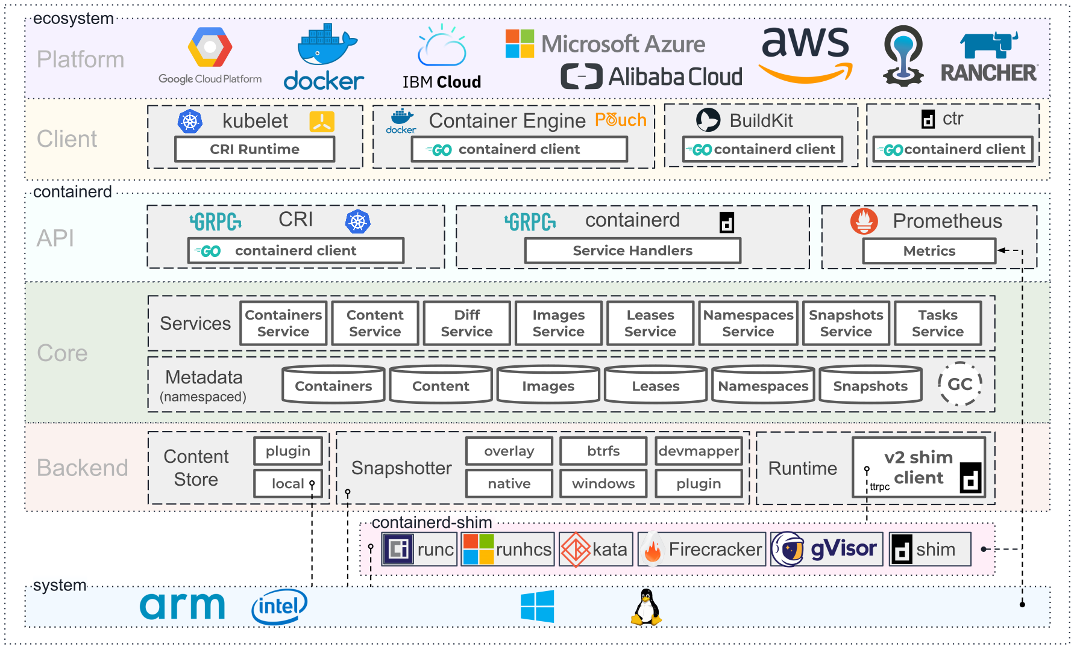
Docker and Containerd
Nikolaos Astyrakakis MTP235

Slide 6
Docker and Containerd
Nikolaos Astyrakakis MTP235

Slide 7
Docker and Containerd
Nikolaos Astyrakakis MTP235

Slide 8
Docker and Containerd
Nikolaos Astyrakakis MTP235

Slide 9
Docker and Containerd
Nikolaos Astyrakakis MTP235

Slide 10
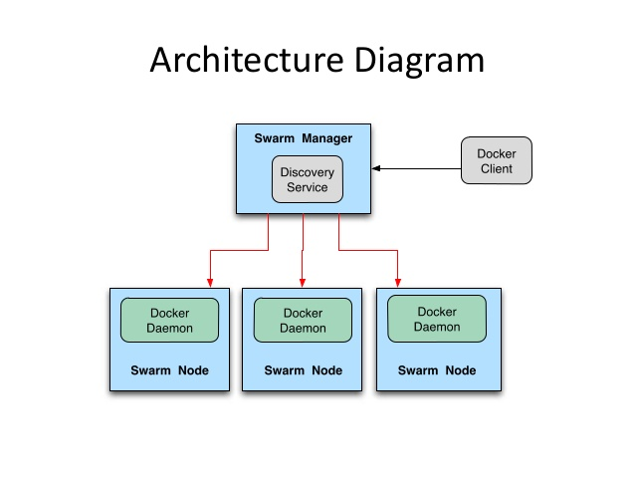
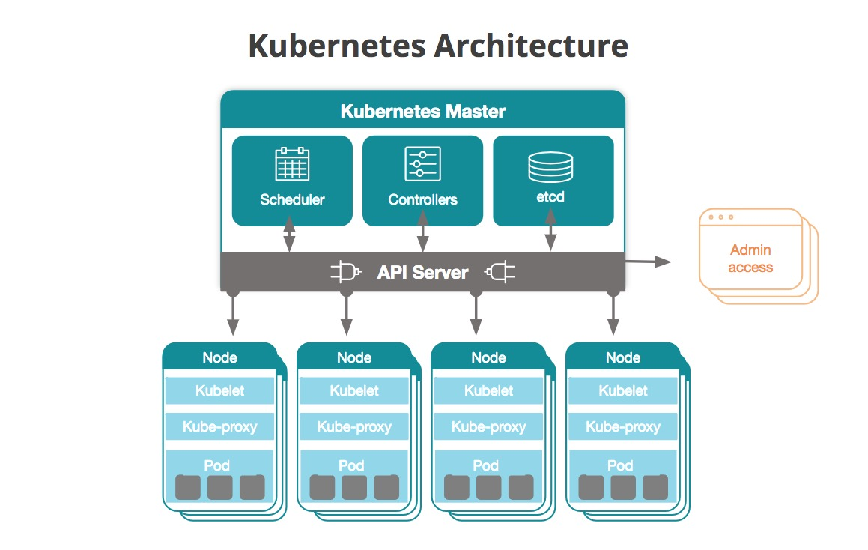
Container and Clustering
Docker Swarm Architecture
Docker Swarm mode:
Master-slave architecture
Multiple Masters - Multiple Worker Nodes
Integrated in Docker tool.
No self healing.
No Support for Clustering of etcd.
CLI control.
Low community and support.
Kubernetes Clustering:
Master-slave architecture
Multiple Masters - Multiple Worker Nodes
Installed as standalone cluster.
Self healing cluster.
Support Clustering of etcd.
CLI control.
Third-party UI Control center (Lens)
Huge community and support.
Multiple advantages and features against docker swarm.
Kubernetes Architecture
Nikolaos Astyrakakis MTP235

Slide 11

Container and Clustering
Cluster
Nikolaos Astyrakakis MTP235

Slide 12
Other Useful Tools
Portainer:
A web tool to manage, delete and deploy containers.
It uses docker in order to deploy it self.
Web UI for container management.
Integrates “Stacks” for using docker-compose.
Can run docker swarm mode.
Docker-Compose:
A CLI tool for deploying and managing multiple containers simultaneously.
Uses YAML files to define docker settings.
Command Line Tool (CLI)
Linux, MacOS, Windows / Windows Server (a lot of issues)
Nikolaos Astyrakakis MTP235

Slide 13
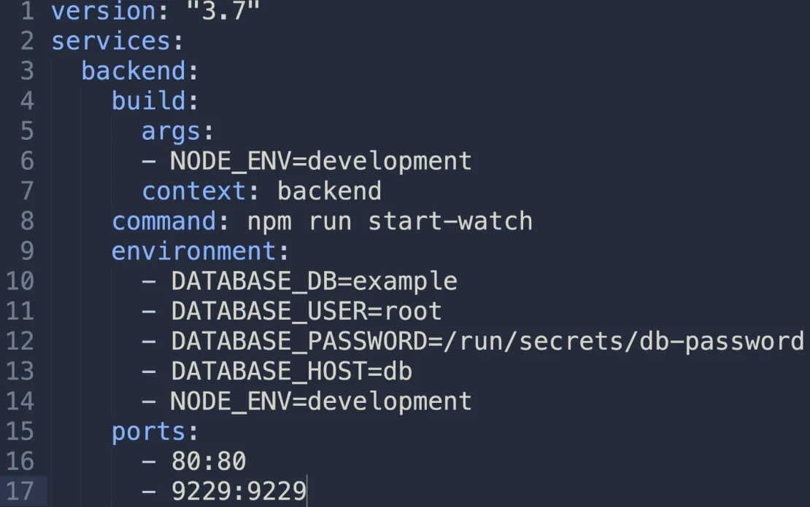
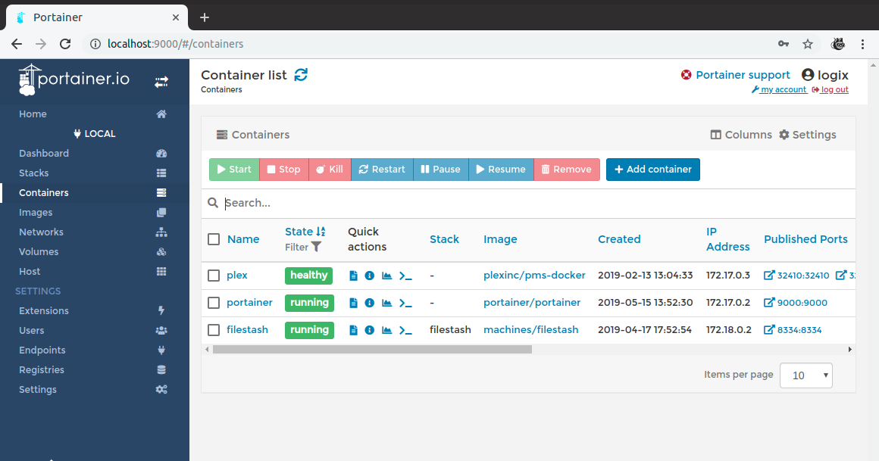
Other Useful Tools
Portainer:
Docker-Compose:
Nikolaos Astyrakakis MTP235

Slide 14
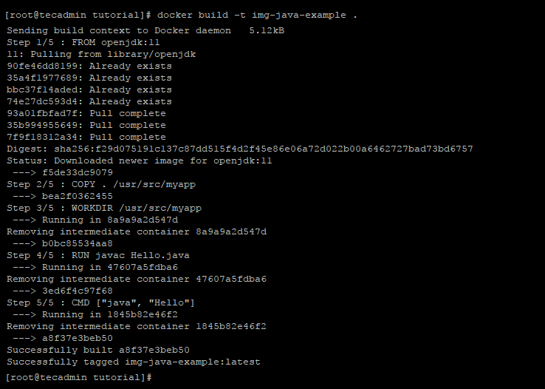
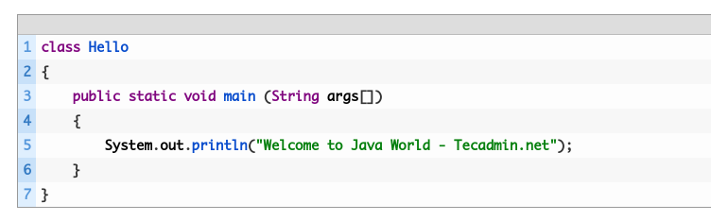
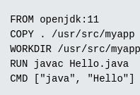
Building and Running a Container with Docker
My App
Container Image Build
Dockerfile
Nikolaos Astyrakakis MTP235

Slide 15
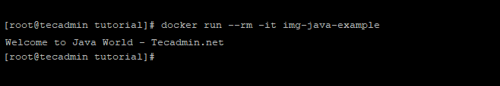
Building and Running a Container with Docker
Running a container with the image we previously build
Docker
Container Image Build
version: "3.3"
services:
java-1:
build: . #Optional
ports:
- "80:80"
java-2:
image: "img-java-example"
Docker Compose
[root@tutorial]# docker-compose up -d
Nikolaos Astyrakakis MTP235

Slide 16
Time for some demos...
References
https://www.ibm.com/cloud/learn/virtualization-a-complete-guide
https://en.wikipedia.org/wiki/Virtualization
https://www.docker.com
https://containerd.io
https://kubernetes.io
https://www.educba.com/docker-swarm-architecture
https://docs.docker.com/engine/swarm
https://etcd.io/
https://tecadmin.net/tutorial/docker-java-example
https://www.portainer.io
https://docs.docker.com/docker-for-windows/install/
https://docs.docker.com/engine/install/ubuntu/
Nikolaos Astyrakakis MTP235

